Slide 1
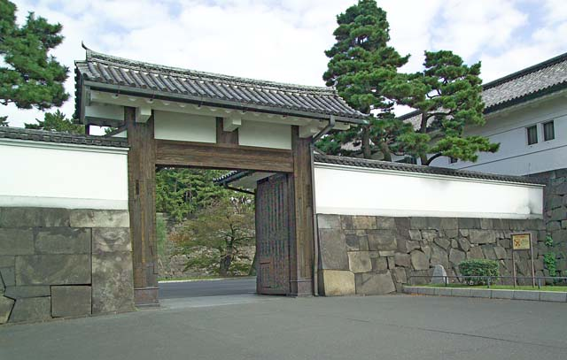
On the Eve of Tokugawa Japan

Slide 2
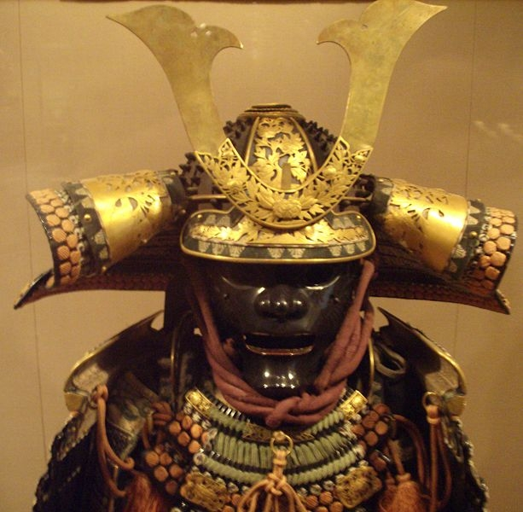
Samurai 侍
Members of the Japanese warrior class first gained influence during the Heian period (794-1185) when powerful landowners hired these military men as bodyguards and for the protection of their properties.
The Samurai’s importance as Japan’s social elite would begin in the Kamakura period (1185-1333).
Daimyo: a member of the Japanese nobility, a local lord with a certain amount of taxable rice lands.

Slide 3
Political Change
In 1190, faction within the Fujiwara clan seized Heian and established new court, beginning the Kamakura Period (1185-1333).
Minamoto Yoritomo 源 頼朝(1147-99): Japanese warrior and founder in 1192 of the Bakufu ("Tent Government") style of central rule, with the new type of central authority in the form of the Seii-tai-shogun 征夷大将軍 "Barbarian-Subduing General" (later Shogun), who was served by outlying Daimyo feudal lords.
The Shogunate form of feudal government would last in Japan for nearly 700 years.

Slide 4
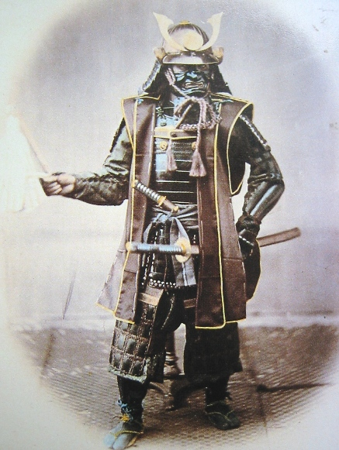
Japanese Feudalism
Feudalism: a contractual political and military system, in which a ruler grants lands (fiefs) to individuals who pay rent through military service and other types of assistance to the ruler.

Slide 5
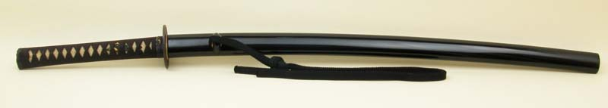
Emergence of a samurai/ bushi (武士) culture
Buddhist, Confucian (particularly after 1600) and Shinto ideas all influenced the common culture of the Shinto class.
Honor in battle, loyalty and sincerity became common values, although adherence may be exaggerated.
The most notable traits are the adoption of the cherry blossom and sword-play as group symbols.
“Way of the Samurai” 1983 BBC film clip: http://www.youtube.com/watch?v=CEeW-CFyJVchttp://www.youtube.com/watch?v=CEeW-CFyJVc

Slide 6
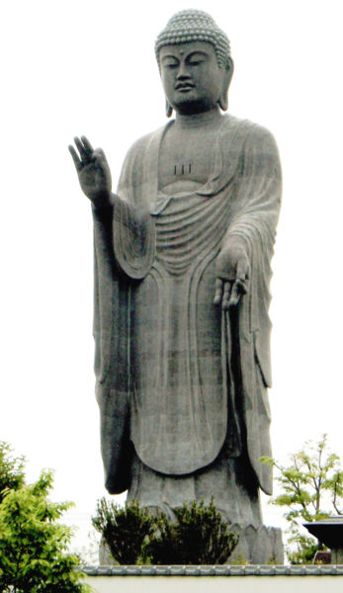
Intellectual Change
Spread of Buddhism, particularly the Pure Land and Zen sects. Largely illiterate warrior class preferred the non-text dependent Zen style of Buddhist worship.
Pure Land worship was based on individual practice, specifically chanting the phrase" A-mito-fo (Amida Buddha, Boddhisatva of Paradise)." Salvation through faith and meditation.

Slide 7
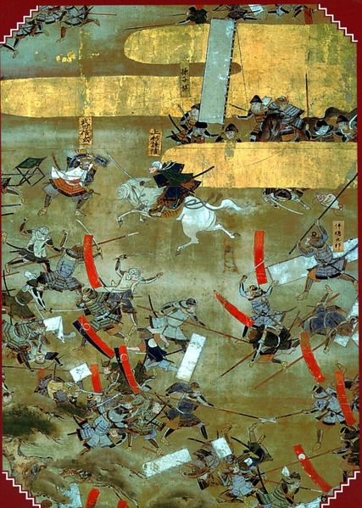
Sengoku Era (1467-1573): Japan’s ”Warring States” period.
Onin War (1467-77): end of Ashikaga足利氏 clan power and beginning of civil war.
Rise of Daimyo administration as dominant local administration.

Slide 8
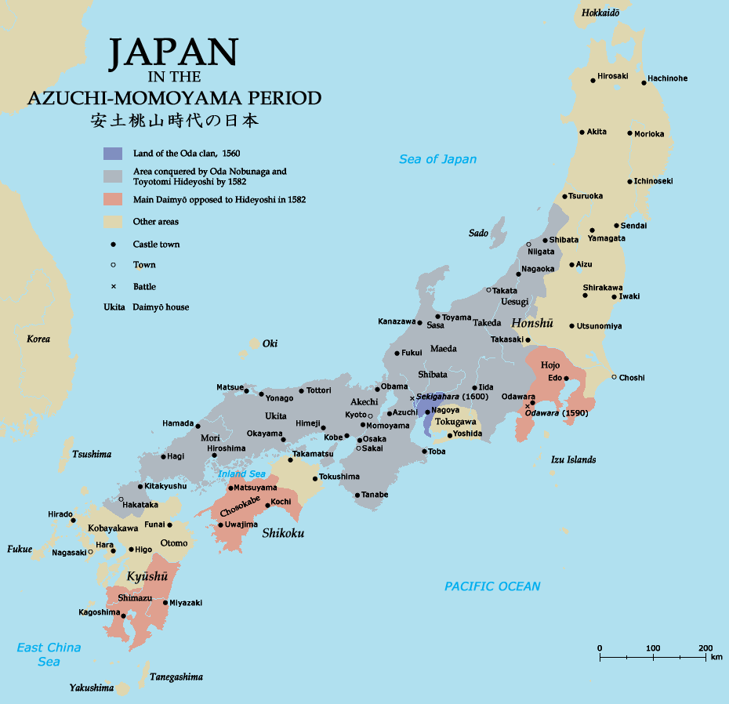

Slide 9
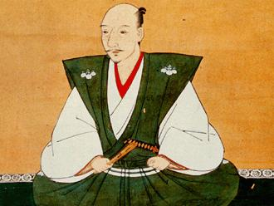
Oda Nobunaga (1534-1582)
First individual to attempt to unify Japan at the end of the Sengoku Era. Oda’s goal was to bring all of Japan under one military leader (tenka-fubu天下布武 ). Although he failed in this attempt, assassinated by two of his generals at 48, his centralizing efforts were realized by Toyotomi Hideyoshi.

Slide 10
Toyotomi Hideyoshi (ca. 1536-1598)
Low-ranking soldier, nicknamed “Saru (Monkey),” who rose to become, along with Tokugawa Ieyasu, a leading general in Oda Nobunaga’s army.
Following Nobunaga’s death in 1582, Hideyoshi eventually reunified Japan after centuries of civil war..
Hideyoshi made a Shinto deity shortly after his death and given the title, Hokoku 豊国, or "Wealth of the Nation,” given his redirecting of riches to the upper strata of his samurai followers..

Slide 11
Hideyoshi’s Desire for Order and Wealth
In 1586, Hideyoshi codified in law the samurai class as permanent and heritary social elite, marked by the prohibition on non-samurai to carry weapons. This act effectively ended the social mobility of Japan from which Hideyoshi himself had benefitted. He also required samurai to leave farming to the peasant class, and take up residence in castle towns.
“The government that he built was founded on the old feudal system of personal loyalties rather than administrative centrality. (Hooker, WSU).”
In 1592 and 1597, he unsuccessfully invaded Korea to prepare for the conquest of China through Korea.

